Slide 1
Pipelining

Slide 2
Pipelining: Basic Concept - Pipeline Organization - Pipelining Issues – Data Dependencies - Memory Delays- Branch Delays - Superscalar Operation - Pipelining in CISC Processors.

Slide 3
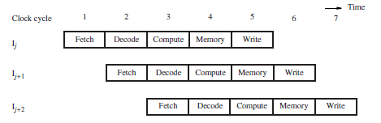
The speed of execution of programs is influenced by many factors. One way to improve performance is to use faster circuit technology to implement the processor and the main memory.
Another possibility is to arrange the hardware so that more than one operation can be performed at the same time.
Pipelining is a particularly effective way of organizing concurrent activity in a computer system

Slide 4
Pipeline Organization
In the first stage of the pipeline, the program counter (PC) is used to fetch a new instruction.
As other instructions are fetched, execution proceeds through successive stages.
At any given time, each stage of the pipeline is processing a different instruction.
Information such as register addresses, immediate data, and the operations to be performed must be carried through the pipeline as each instruction proceeds from one stage to the next. This information is held in interstage buffers.

Slide 5
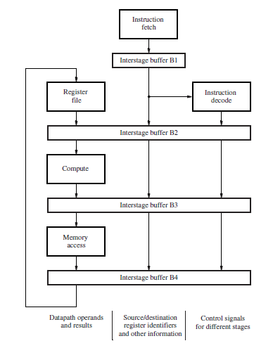
A five-stage pipeline

Slide 6
Pipeline Hazards
Structural hazards: attempt to use the same resource two different ways at the same time
E.g., combined washer/dryer would be a structural hazard or folder busy doing something else (watching TV)
Data hazards: attempt to use item before it is ready
E.g., one sock of pair in dryer and one in washer; can’t fold until get sock from washer through dryer
instruction depends on result of prior instruction still in the pipeline
Control hazards: attempt to make a decision before condition is evaulated
E.g., washing football uniforms and need to get proper detergent level; need to see after dryer before next load in
branch instructions

Slide 7
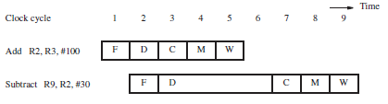
Data Dependencies
Add R2, R3, #100
Subtract R9, R2, #30
Pipeline stall due to data dependency.
Each NOP creates one clock cycle of idle time, called a bubble, as it passes through the Compute, Memory, and Write stages to the end of the pipeline.

Slide 8
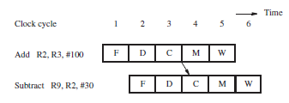
Operand Forwarding
Pipeline stalls due to data dependencies can be alleviated through the use of operand forwarding.
Add R2, R3, #100
Or R4, R5, R6
Subtract R9, R2, #30
Avoiding a stall by using operand forwarding.

Slide 9
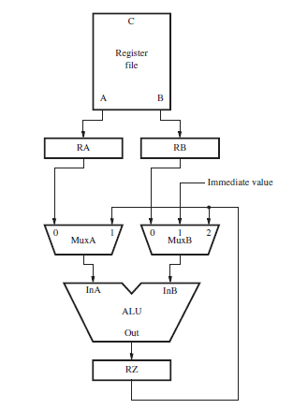

Slide 10
Handling Data Dependencies in Software
An alternative approach is to leave the task of detecting data dependencies and dealing with them to the compiler.
When the compiler identifies a data dependency between two successive instructions Ij and Ij+1, it can insert three explicit NOP instructions between them.
The NOPs introduce the necessary delay to enable instruction Ij+1 to read the new value from the register file after it is written.
Add
NOP
NOP
Subtract
NOP
R2, R3, #100
R9, R2, #30
Insertion of NOP instructions for a data dependency

Slide 11
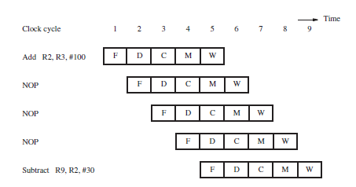
Pipelined execution of instructions

Slide 12
Memory Delays
Delays arising from memory accesses are another cause of pipeline stalls. For example, a Load instruction may require more than one clock cycle to obtain its operand from memory.
This may occur because the requested instruction or data are not found in the cache, resulting in a cache miss.
A memory access may take ten or more cycles.
A cache miss causes all subsequent instructions to be delayed. A similar delay can be caused by a cache miss when fetching an instruction.
Load R2, (R3)
Subtract R9, R2, #30

Slide 13
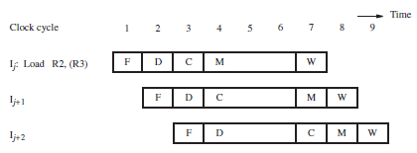
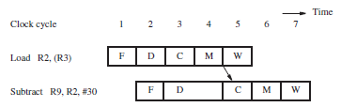
Stall caused by a memory access delay for a Load instruction.
Stall needed to enable forwarding for an instruction that follows a Load instruction.

Slide 14
Branch Delays
Branch instructions can alter the sequence of execution, but they must first be executed to determine whether and where to branch.
Branch instructions occur frequently. In fact, they represent about 20 percent of the dynamic instruction count of most programs.
Reducing the branch penalty requires the branch target address to be computed earlier in the pipeline.

Slide 15
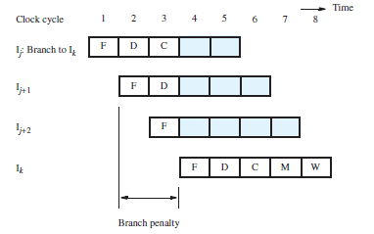
Unconditional branches
Reducing the branch penalty requires the branch target address to be computed earlier in the pipeline
Branch penalty when the target address is determined in the Compute
stage of the pipeline.

Slide 16
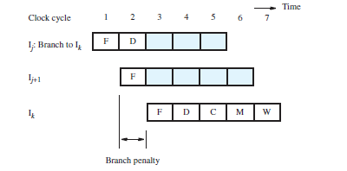
Target address is determined in the decode stage of the pipeline
Branch penalty when the target address is determined in the
Decode stage of the pipeline

Slide 17
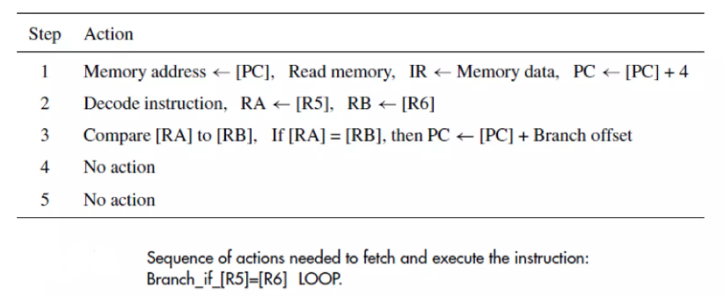
Conditional branches
For pipelining, the branch condition must be tested as early as possible to limit the branch penalty

Slide 18
The Branch Delay Slot
The location that follows a branch instruction is called the branch delay slot
Rather than conditionally discard the instruction in the delay slot, we can arrange to have the pipeline always execute this instruction, whether or not the branch is taken

Slide 19
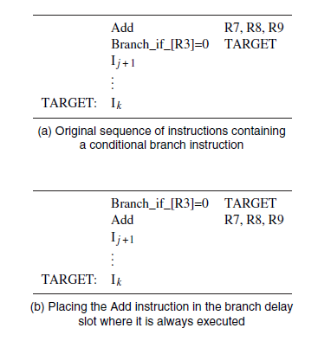

Slide 20
Branch prediction
To reduce the branch penalty further, the processor needs to anticipate that an instruction being fetched is a branch instruction
Predict its outcome to determine which instruction should be fetched.
Static branch prediction
The simplest form of branch prediction is to assume that the branch will not be taken and to fetch the next instruction in sequential address order.
If the prediction is correct, the fetched instruction is allowed to complete and there is no penalty.
Misprediction incurs the full branch penalty

Slide 21
In static prediction, all decisions are made at compile time, before the execution of the program. Dynamic branch prediction. Dynamic branch prediction uses information about taken or not taken branches gathered at run-time to predict the outcome of a branch.

Slide 22
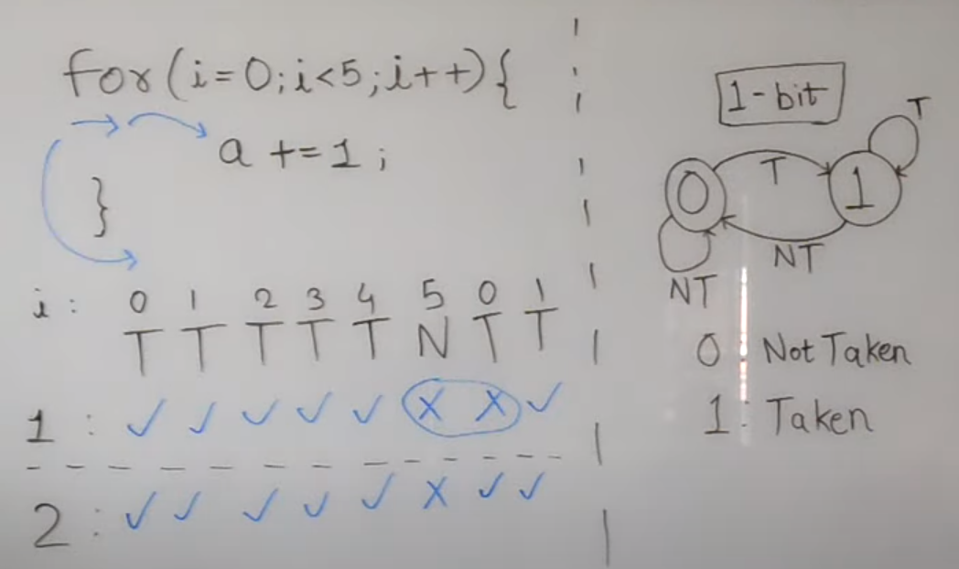

Slide 23
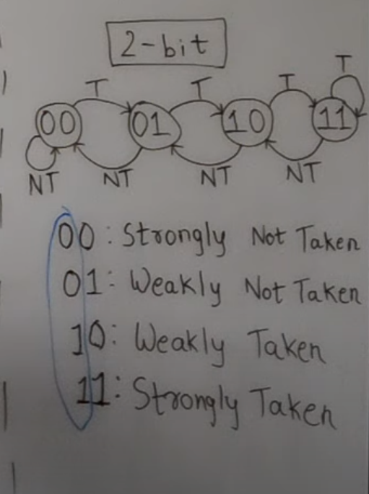

Slide 24
Dynamic branch prediction
The processor hardware assesses the likelihood of a given branch being taken by keeping track of branch decisions every time that a branch instruction is executed.
Dynamic prediction algorithm can use the result of the most recent execution of a branch instruction
The processor assumes that the next time the instruction is executed, the branch decision is likely to be the same as the last time.
LT - Branch is likely to be taken
LNT - Branch is likely not to be taken

Slide 25
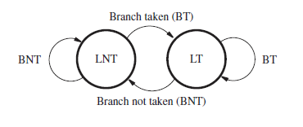
A 2-state algorithm
When the branch instruction is executed and the branch is taken, the machine moves to state LT. otherwise, it remains in state LNT
The next time the same instruction is encountered, the branch is predicted as taken if the state machine is in state LT. Otherwise it is predicted as not taken.

Slide 26
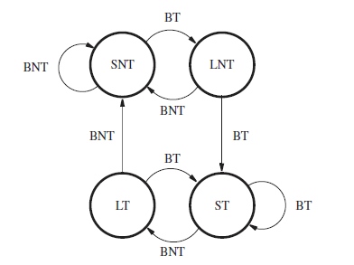
A 4-state algorithm
After the branch instruction is executed, and if the branch is actually taken, the state is changed to ST; otherwise, it is changed to SNT.
The branch is predicted as taken if the state is either ST or LT. Otherwise, the branch is predicted as not taken.

Slide 27

Performance evaluation
Basic performance equation
For a non-pipelined processor, the execution time, T, of a program that has a dynamic instruction count of N is given by
S is a average number of clock cycles it takes to fetch and execute one instruction
R is the clock rate in cycles per second

Slide 28

Instruction throughput
Number of instructions executed per second. For non-pipelined execution, the throughput, Pnp, is given by
The processor with five cycles to execute all instructions.
If there are no cache misses, S is equal to 5

Slide 29
For the five-stage pipeline, each instruction is executed in five cycles, but a new instruction can ideally enter the pipeline every cycle.
Thus, in the absence of stalls, S is equal to 1, and the ideal throughput with pipelining is
Pp = R
A five-stage pipeline can potentially increase the throughput by a factor of five.
In general, an n-stage pipeline has the potential to increase throughput n times.

Slide 30
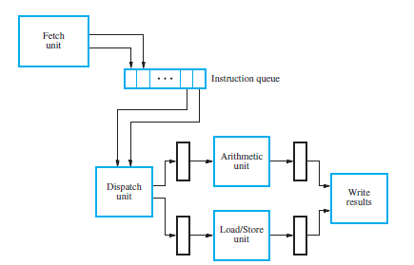
Superscalar Operation

Slide 31

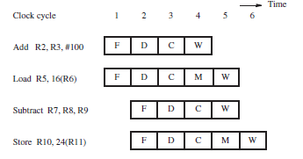

Slide 32
Pipelining in CISC Processors
The instruction set of a RISC processor makes pipelining relatively easy to implement.
All instructions are one word in size, and operand information is typically located in the same position within a word for different instructions.
No instruction requires more than one memory operand. Only Load and Store instructions access memory operands, typically using only indexed addressing
The availability of more complex addressing modes such as Autoincrement or Autodecrement introduces side effects when executing instructions. Aside effect occurs when a location other than that of the destination operand is also affected.
For example, the instruction
Move R5, (R8)+

